Slide 1
Probability and Statistical Inference
Some Key Ideas
Sources used in creation of this lecture:
Discovering Statistics Using R, Field, Miles and Field;
Statistics How To, https://statisticshowto.datasciencecentral.com

Slide 2
Probability Frequency Distribution
Shows how often an event will happen
Sample question:
In a sample of 43 students:
15 had brown hair.
10 had black hair.
16 had blond hair.
2 had red hair.
find the probability a person has neither red nor blond hair.

Slide 3
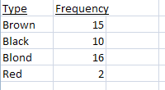
Probability Frequency Distribution
Frequency distribution table:
Brown = 15/43 (15 out of 43 students have brown hair).
Black = 10/43 (10 out of 43 students have black hair).
Add these together to get the total number of students who have either brown or black hair
15/43 + 10/43 = 25/43
(25 out of 43 students have either brown or black hair).

Slide 4
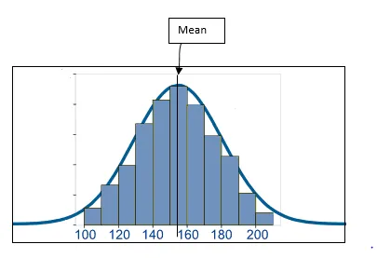
Frequency Distribution to Probability
Frequency distribution can be displayed as a histogram - gives us an idea about how frequently a given data point occurs
And from this probability can be calculated and using probability density function (equation/function)
And using this you can plot the probability distribution

Slide 5
Continuous Random Variables
Suppose we are trying to calculate the amount of rain that will fall tomorrow.
Suppose the rainfall is likely to be around 2 cm.
Will it be exactly 2 cm?
It could be 2.001 or 2.000001 or 2.000000001 and an infinite number of values in between.
We calculate the probability of it being in a range
We calculate the probability of rainfall being in the range of 2 cm to 2.01 cm.
It will be the sum of probabilities for all values between 2 and 2.01.

Slide 6
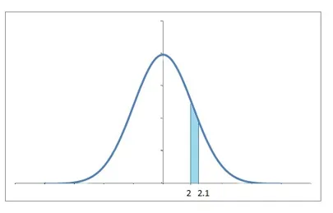
Continuous Random Variables
The area under the probability density function within the limits 2 and 2.01 will give us that probability

Slide 7
Sampling
When you have huge amount of data, it is difficult to make sense of it (or even collect it).
To tackle this problem, what we do is take a small chunk of data and look at it.
But we won’t be satisfied with just a single chunk.
We’d try to look at multiple chunks to be sure of results.

Slide 8
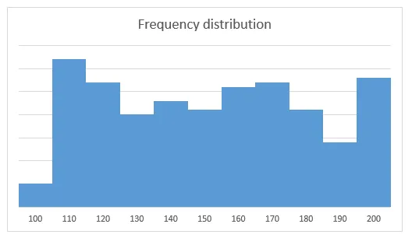
Sampling
Let’s say we have the cholesterol levels of all the people in a country
We can look at the mean, median and mode of the data.
Suppose we plot the data, and it looks like this.
We calculate the mean is 153.2

Slide 9
Sampling
But it is difficult to process this large amount of data.
So we take the data of some 50 people and calculate their mean.
We then take a new sample of 50 people and calculate the mean.
We keep doing that to collect a quantity of samples.

Slide 10
Sampling
We can then plot the means of these samples.
We get a symmetrical frequency distribution.
When we take means of cholesterol levels of 50 people, again and again, we observe the mean values are around 150-160.
Only a few mean values are more than 170 and less than 140.
There are very, very few over 190 or less than 110.

Slide 11
Sampling – Frequency to probability
We can easily convert these frequencies to see probabilities.
If we divide the frequency of a bin (range like 110 to 120) by the total number of data points, we get the probabilities of each bin.
This converts the frequency distribution to a probability distribution of the same shape.

Slide 12
Sampling – Frequency to probability
The probability distribution becomes more and more symmetrical when the sample size that we use to create those means is very large.
As the sample size approaches infinity, the probability distribution becomes a perfectly symmetrical where the center of the curve is the mean of the population – the central limit theorem.
The curve is known as normal distribution.

Slide 13
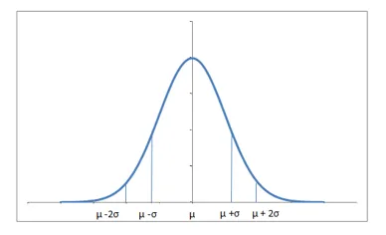
Normal Distribution
The normal distribution is perfectly symmetrical about the mean.
The probabilities move similarly in both directions around the mean.
The total area under the curve is 1, since summing up all the possible probabilities would give 1.

Slide 14
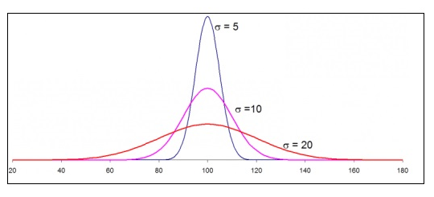
Normal distribution
The distribution might vary a bit depending upon how spread the data is.
If the data has a very large standard deviation, the curve would be spread out and flatter since more of the values would be away from the mean.

Slide 15
Normal distribution
If our population distribution is expected to follow the normal distribution,
Then we can consider the sample distribution (of our sample means) and its shape and make some comments about how good an estimate it is of our population.

Slide 16
Normal distribution
If a lot of values are away from the mean, the probability for data being around the population mean also drops.

Slide 17
Normal distribution
Similarly, if the standard deviation is low, which means most of the values are near around the mean, there is high probability of the sample mean being around the population mean and the distribution is a lot thinner.

Slide 18
The Standard Normal
A normal distribution with a mean of 0 and a standard deviation of 1 is called a standard normal distribution.
Any normal distribution in any scale can be converted to the standard normal by transforming the scale to be in units of standard deviation.

Slide 19
Z Scores
We encounter a lot of situations where we would need to know the probability for the data to be less than or more than a particular value.
This value will not always be equal to 1σ or 2σ away from the mean.
The distance in terms of number of standard deviations, the observed value is away from the mean, is the standard score or the Z score.

Slide 20
Z Scores
Observed value = µ+zσ
µ is the mean and σ is the standard deviation
Or z=X- µ/σ where X is our observed value
In our cholesterol example, if our observed value is172 – where does this fall in our distribution?
If our mean is 150 and standard deviation is 15.
To find the percentage of people that have cholesterol less than 172 first calculate the Z score
This is 1.47 {(172-150)/15} or 1.47 standard deviations more than the mean. This 1.47 is known as the z value.
Then use these to calculate the area under the curve.
Remember that the area under the curve is 1.

Slide 21
Z Scores
To calculate the probability of people having a cholesterol level of less than 172 we have the z table (https://s3.amazonaws.com/udacity-hosted-downloads/ZTable.jpg) that can be used to calculate the probabilities for particular z values.
The rows of the Z table have the Z score in tens, while the hundredths decimal is given by the columns (Stem and Leaf lookup.
The value is the area under the curve less than that Z score.

Slide 22
Z Scores
The value is the area under the curve less than that Z score.
If we look out for 1.47, we find that 93% data falls less than that (1-0.0708).
Therefore, 93% patients have cholesterol less than 172.
Also, we can say that 7% of patients have cholesterol more than 172.

Slide 23
Critical Value of Z
“Critical" values of z are associated with interesting central areas under the standard normal curve.

Slide 24
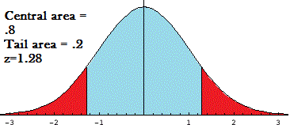
Critical Value of Z
For a central area (blue) there is a corresponding tail area (red)
Since there are two “tails", the central area is always 1 – 2*tail area
Critical z values are often denoted by z_{α}, where the subscript α (alpha) is the tail area/2.

Slide 25
Critical Value – Central Region
The z-score is equal to the number of standard deviations from the mean.
A score of 1.28 indicates that the variable is 1.28 standard deviations from the mean.
If you look in the z-table for a z of 1.28, you’ll find the area is .3997.
This is the region to the right of the mean, so you’ll double it to get the area of the entire central region: .3997*2 = .7994 or about 80 percent.

Slide 26
Critical Value: Tail Region
The area of the tails (the red areas) is 1 minus the central region.
In this example, 1-.8=.20, or about 20 percent.
The tail regions are calculated when you want to know how many variables would be less than or more than a certain figure.

Slide 27
Critical Value: Tail Region
The area of the tails (the red areas) is 1 minus the central region.
In this example, 1-.8=.20, or about 20 percent.
The tail regions are calculated when you want to know how many variables would be less than or more than a certain figure.

Slide 28
Hypothesis testing
In order to decide whether to reject the null hypothesis a test statistic is calculated.
The decision is made based on the numerical value of the test statistic and the implications for the probability of achieving this result.

Slide 29
Hypothesis Testing – Critical Value
The observed test statistic (calculated from the sample data) is compared to the critical value, considered a cutoff value.
If the test statistic is more extreme than the critical value, the null hypothesis is rejected.
If the test statistic is not as extreme as the critical value, the null hypothesis is not rejected.
The critical value is computed based on the given significance level α and the type of probability distribution of the idealized model.
Finding the critical value works the same way as finding the z-score corresponding to any area under the curve.
The critical value divides the area under the probability distribution curve in rejection region(s) and in non-rejection region.

Slide 30
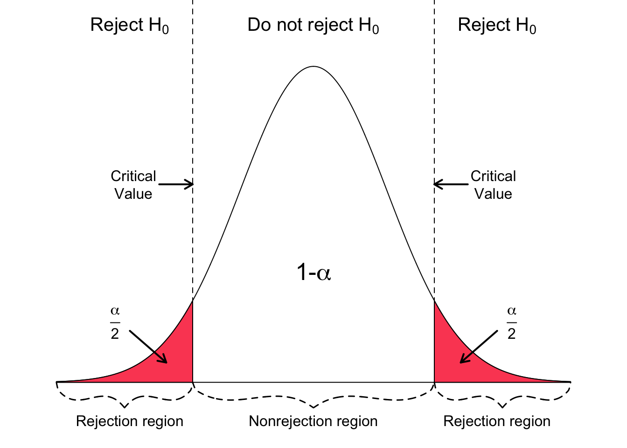
Hypothesis Testing – Critical Value
In a two-sided test the null hypothesis is rejected if the test statistic is either too small or too large.
The rejection region for such a test consists of two parts: one on the left and one on the right.
α =significance level

Slide 31
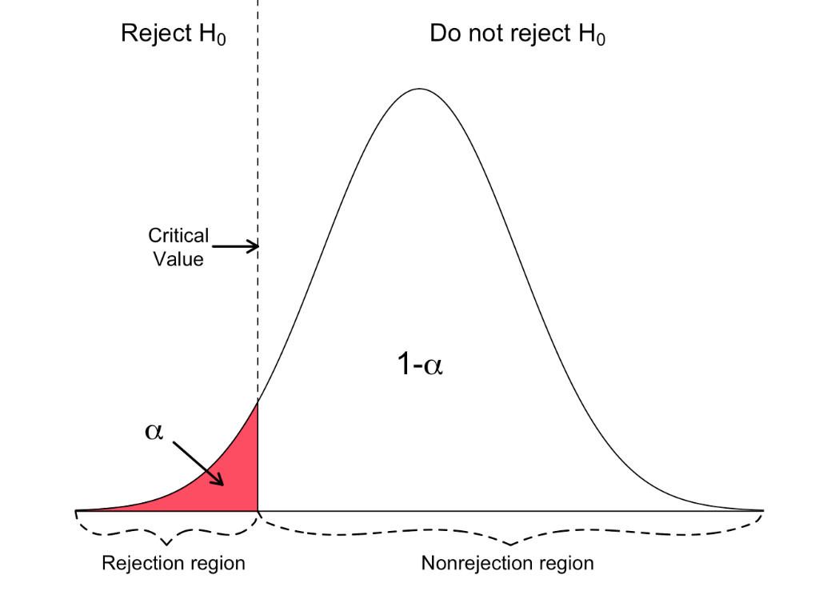
Hypothesis Testing – Critical Value approach
For a left-tailed test, the null hypothesis is rejected if the test statistic is too small.
The rejection region for such a test consists of one part, which is left from the center.
α =significance level

Slide 32
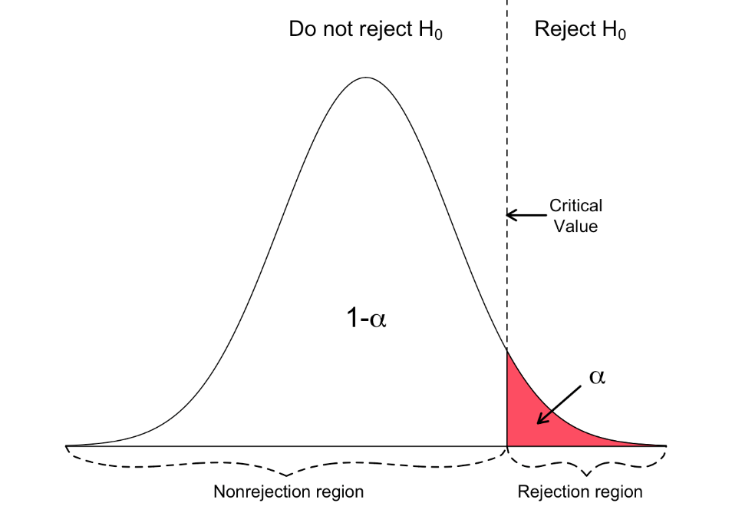
Hypothesis Testing – Critical Value approach
For a right-tailed test, the null hypothesis is rejected if the test statistic is too large.
The rejection region for such a test consists of one part, which is right from the center.
α =significance level

Slide 33
Hypothesis Testing – p value
The p-value is the probability of observing sample data at least as extreme as the observed test statistic given that the null hypothesis is true.
If the p-value is less than or equal to the specified significance level α, the null hypothesis is rejected; otherwise, the null hypothesis is not rejected.
Small p-values provide evidence against the null hypothesis.
The smaller (closer to 0) the p-value, the stronger is the evidence against the null hypothesis (supporting rejection).
In other words, if p≤α, reject H0; otherwise, if p>α do not reject.

Slide 34
Hypothesis Testing - Correlation
The correlation coefficient, r, tells us about the strength and direction of the linear relationship between two concepts of interest represented in our dataset x and y.
We perform a hypothesis test of the “significance of the correlation coefficient” to decide whether the linear relationship in the sample data is strong enough to use to model the relationship in the population.

Slide 35
Hypothesis Testing - Correlation
We calculate a correlation co-efficient r from our sample data
This is an estimate of the unknown population correlation coefficient
We want to decide whether this is a good estimate of population co-efficient
For hypothesis testing we are interested in
Null Hypothesis H₀: The population correlation coefficient IS NOT significantly different from zero.
There IS NOT a significant linear relationship(correlation) between x and y in the population.
Alternate Hypothesis H_{a}: The population correlation coefficient IS significantly DIFFERENT FROM zero.
There IS A SIGNIFICANT LINEAR RELATIONSHIP (correlation) between x and y in the population.

Slide 36
Hypothesis Testing
Confidence in a relationship is formally determined not just by the correlation coefficient but also by the number of pairs in your data.
If there are very few pairs then the coefficient needs to be very close to 1 or –1 for it to be deemed ‘statistically significant’, but if there are many pairs then a coefficient closer to 0 can still be considered ‘highly significant’.

Slide 37
Hypothesis Testing - Correlation
Depending on our level of significance and our sample size n we can use the correlation co-efficient table for your test to identify whether our observed value is significant or not.
Compare the absolute value of r to the appropriate critical value in the table for a sample of equivalent size.
For Pearson (https://www.real-statistics.com/statistics-tables/pearsons-correlation-table/)
For a two-tailed test if our calculated Pearson’s correlation coefficient is greater than the critical value from the table you can reject the null hypothesis

Slide 38
Do we need to look up tables?
No, your statistical software will do it for you and you can report the p-value with confidence
Report p < cut-off if result is statistical significant
Report actual value of p if not statistical significant

